Slide 1


Slide 2
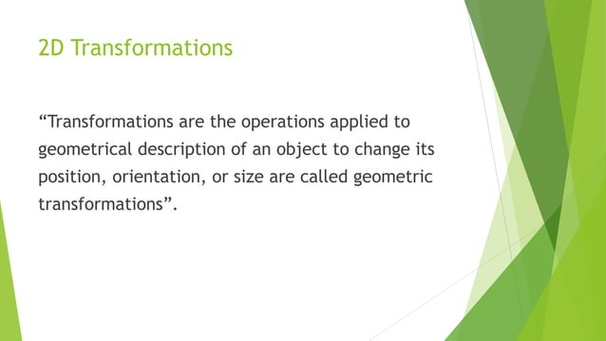

Slide 3
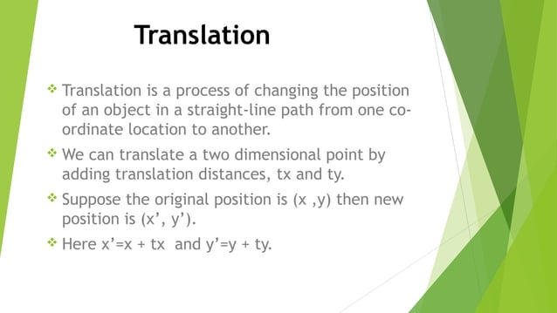

Slide 4
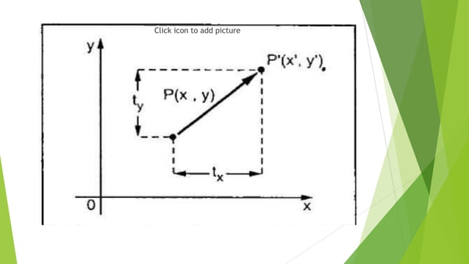

Slide 5
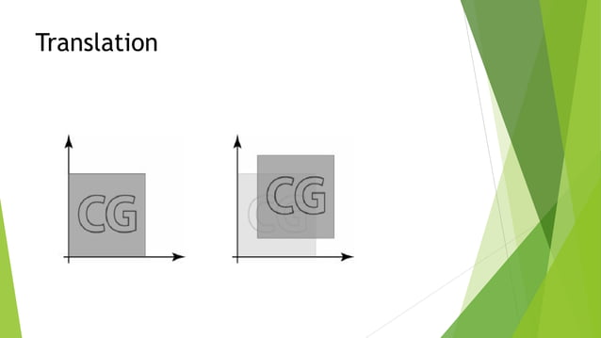

Slide 6
Translate the point (2,4) where T(-1,14) Find P’
Translate the polygon with A(2,7) B(7,10) C(10,2) by 3 units in X direction and 4 units in Y direction

Slide 7
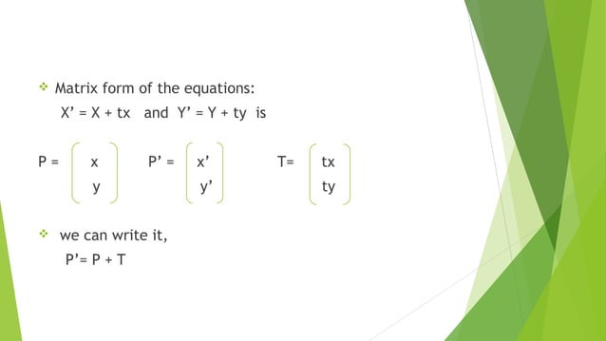

Slide 8
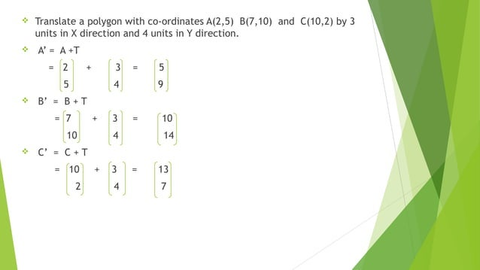

Slide 9
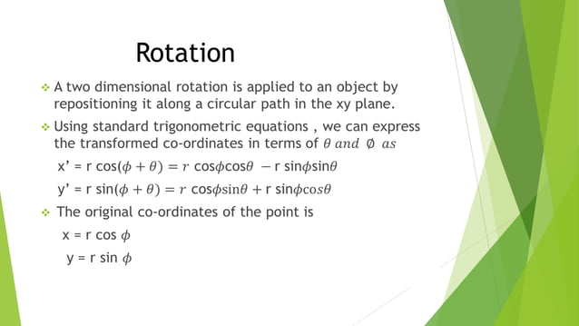

Slide 10
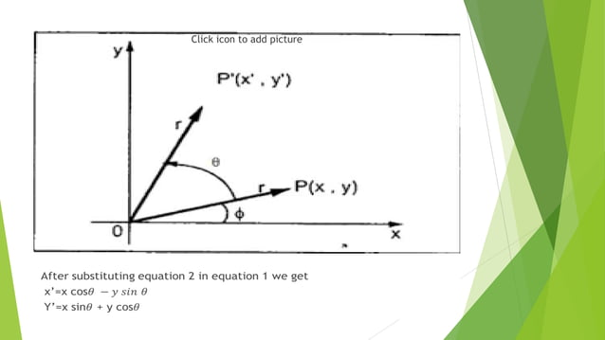

Slide 11
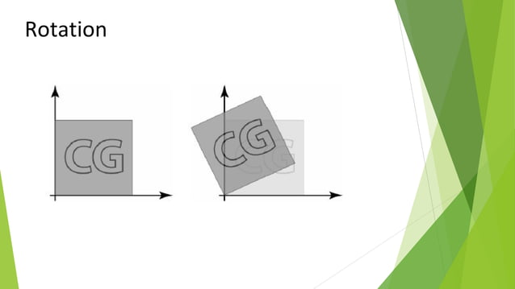

Slide 12
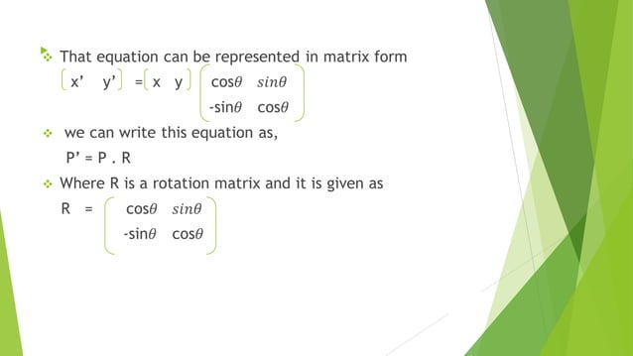

Slide 13
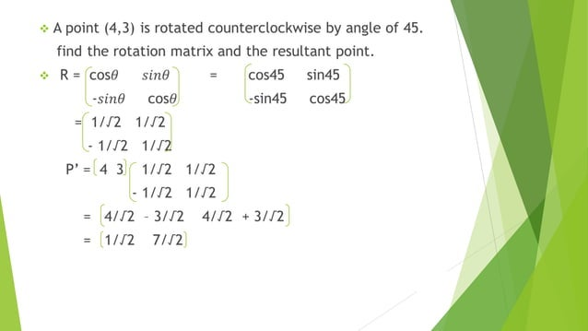

Slide 14
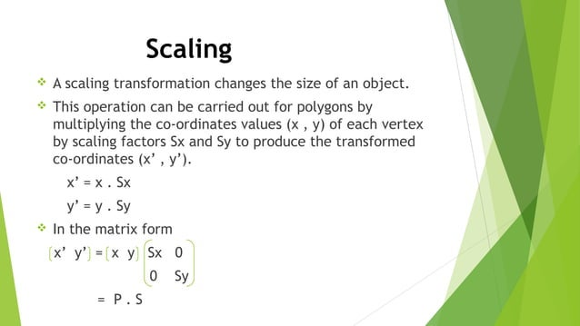

Slide 15
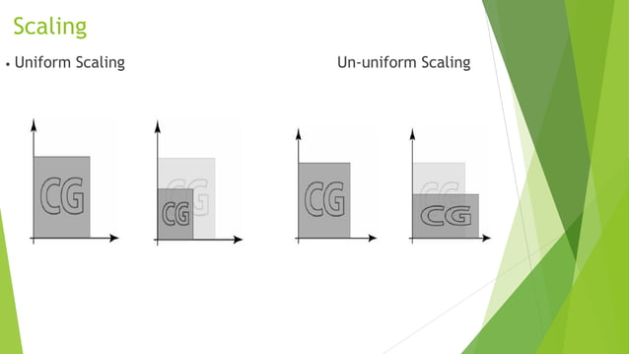

Slide 16
Ex. Scale a polugon with co-ordinates A(2,5), B(7,10) and C(10,2) by 2 units in X direction and 3 units in Y direction

Slide 17
Translate a square ABCD A(0,0),B(3,0), C(3,3) and D(0,3) by 2 units in both direction then scale it by 1:5 units in X-direction and 0.5 in Y direction. Determine the resultant co-ordinated of polygon

Slide 18
Answer
Translation:
A’(2,2) B’(5,2) C’(5,5) D’(2,5)
Scaling:
A’’(3,1) B’’(7.5,1) C”(7.5,2.5) D”(3,2.5)

Slide 19
Ex. Magnify the triangle with vertices (0,0),(1,1),(5,2) to twice its size while keeping (5,2) fixed
Scaling: A’(0,0) B’(2,2) C’(10,4)
Traslation: A”(-5,-2) B”(-3,0) C”(5,2)

Slide 20
Rotate a Triangle A(0,0) B(2,2) C(4,2) about the origin by an angle of 45°

Slide 21
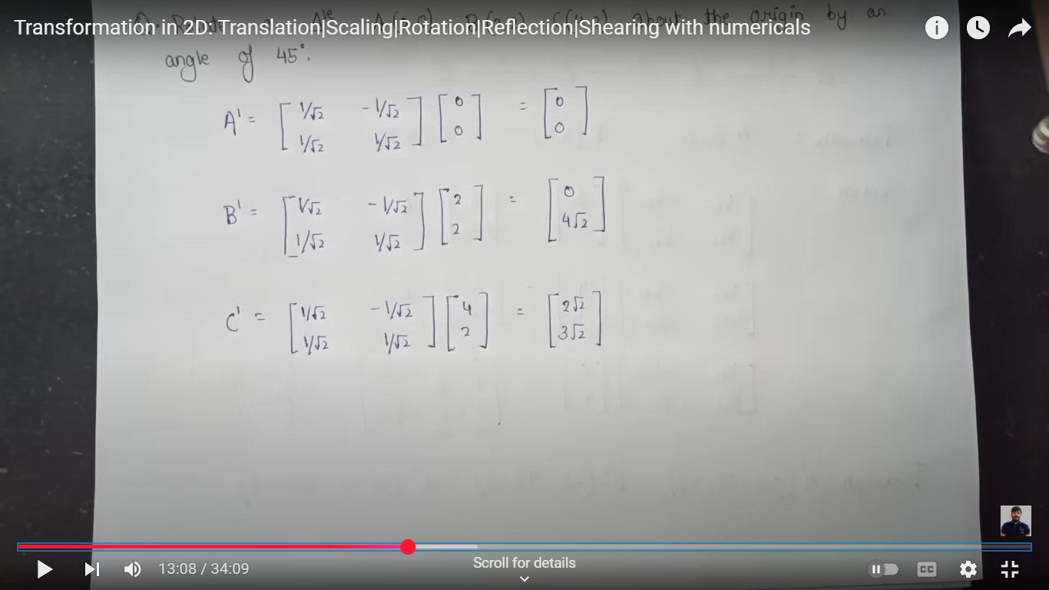

Slide 22
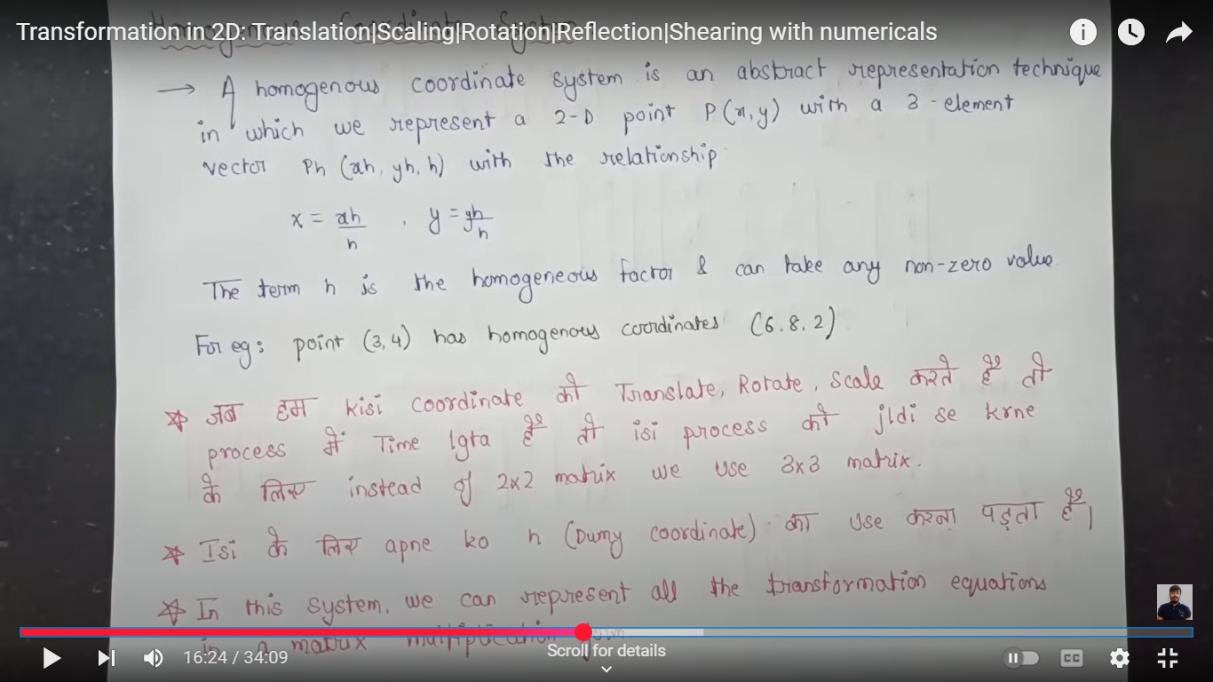

Slide 23
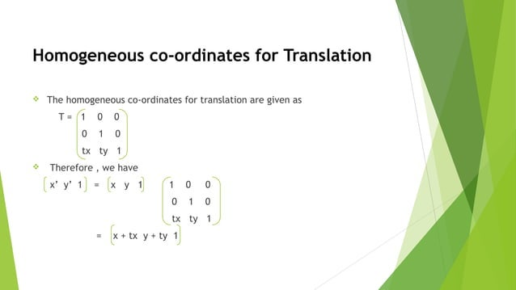

Slide 24
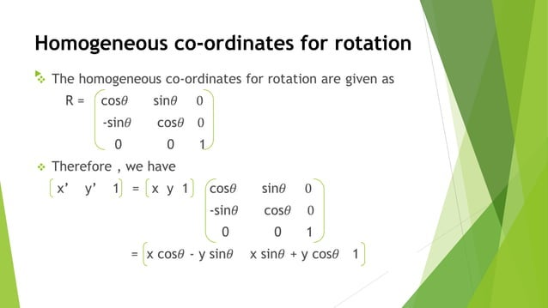

Slide 25
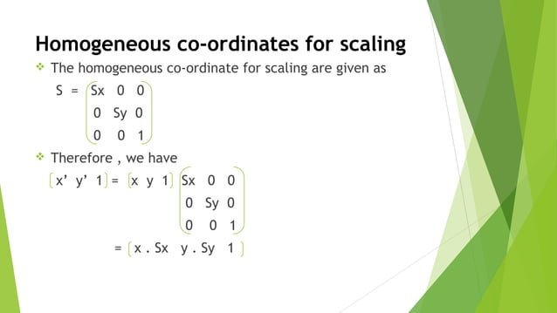

Slide 26
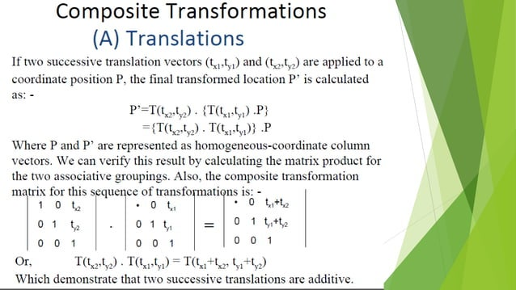

Slide 27
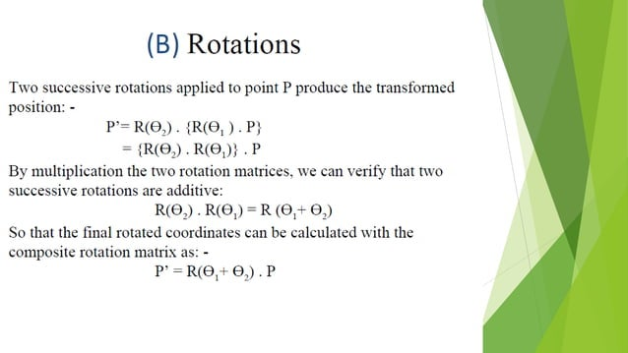

Slide 28
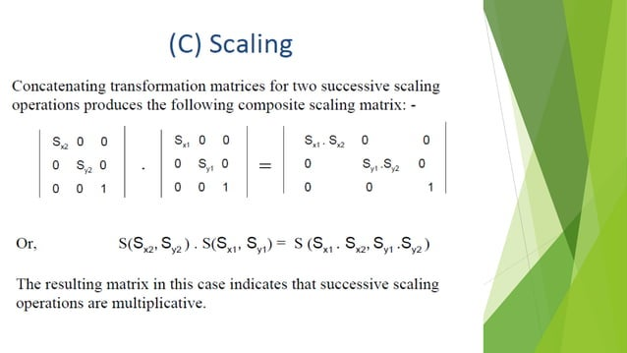

Slide 29
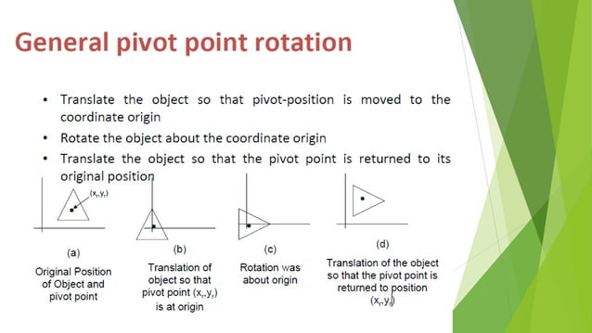

Slide 30
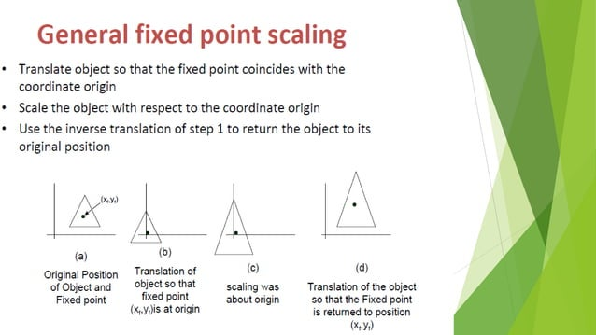

Slide 31
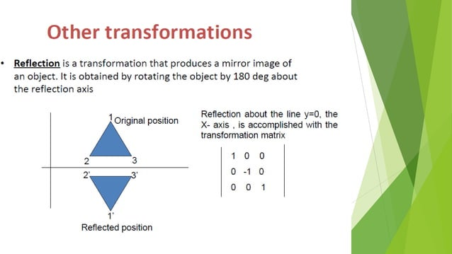

Slide 32
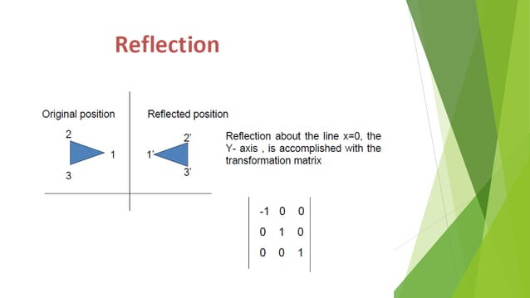

Slide 33
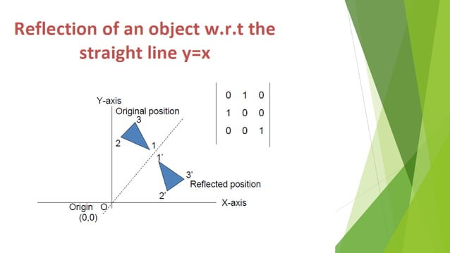

Slide 34
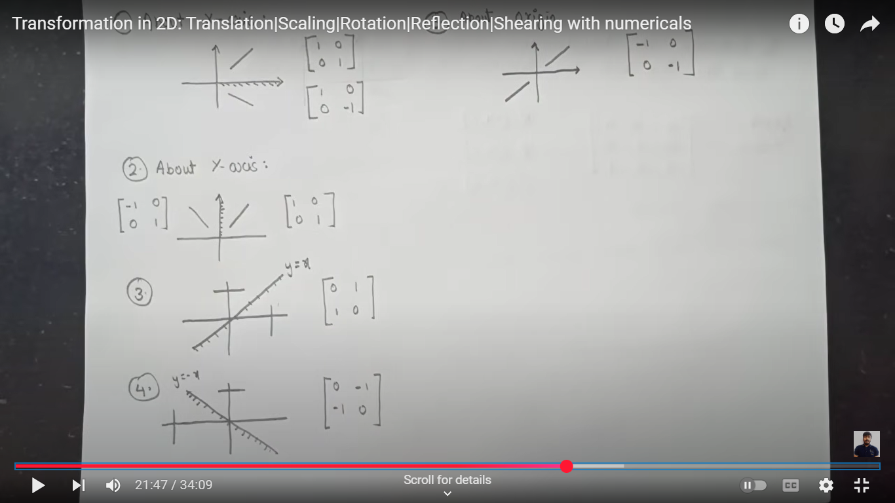

Slide 35
Determine the transformation matrix of a triangle A(4,1) B(5,2) C(4,3) about the line x=0 and determine the resultant co-ordinates.

Slide 36
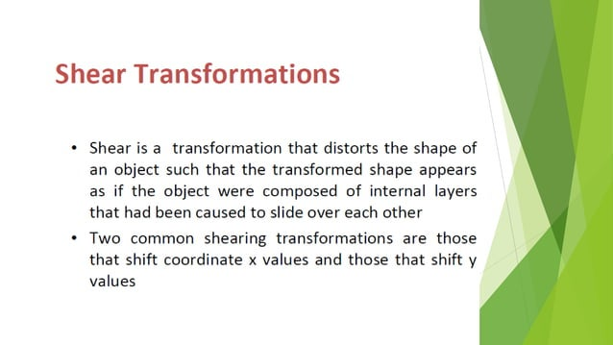

Slide 37
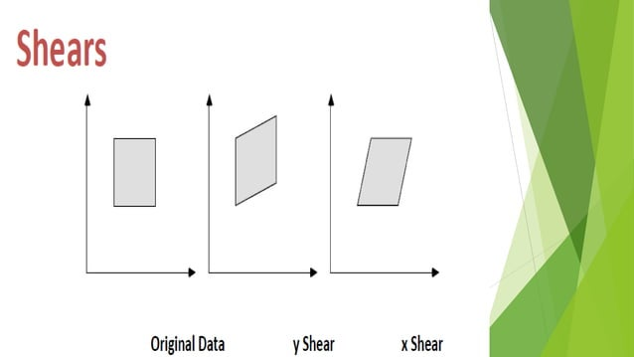

Slide 38
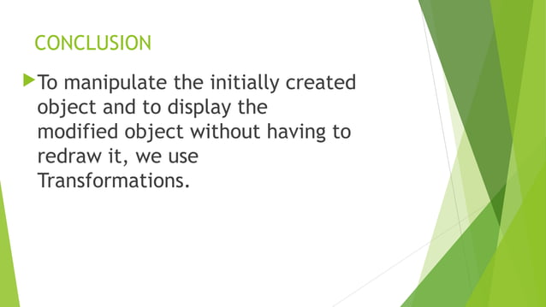

Slide 39


